Slide 1
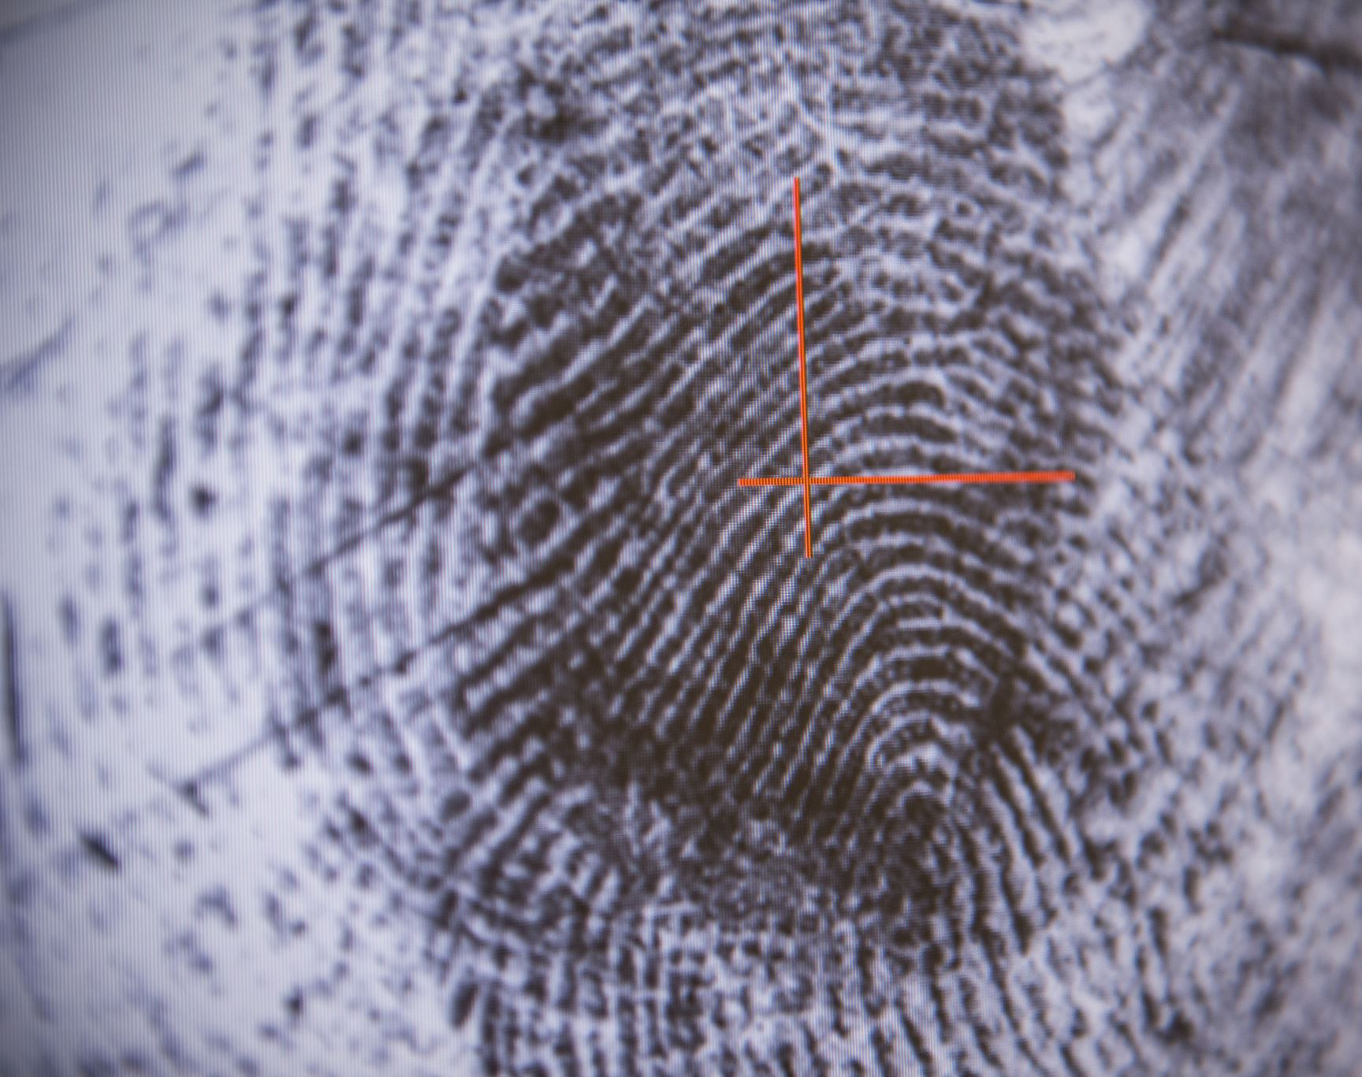
Crime Prediction in SA
Paul Smith
psmith19@mail.stmarytx.edu

Slide 2
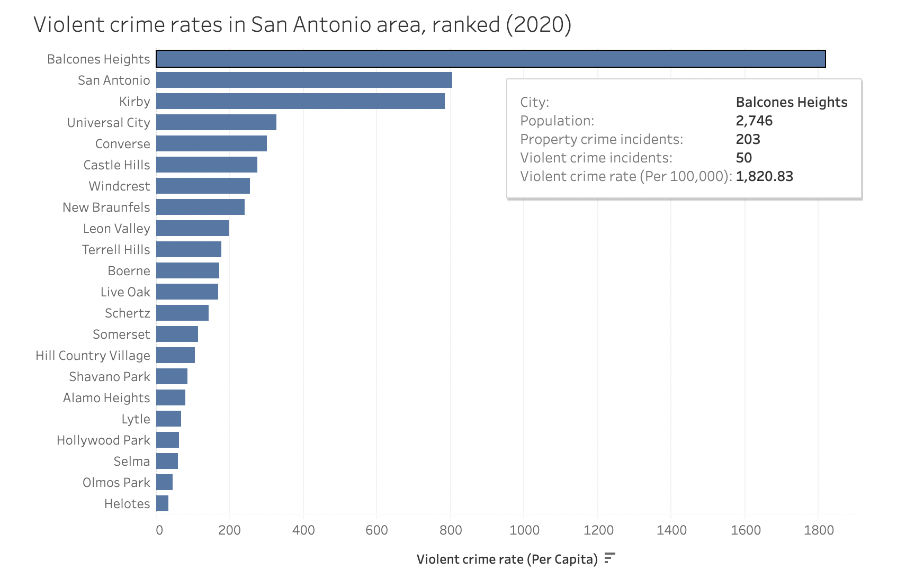
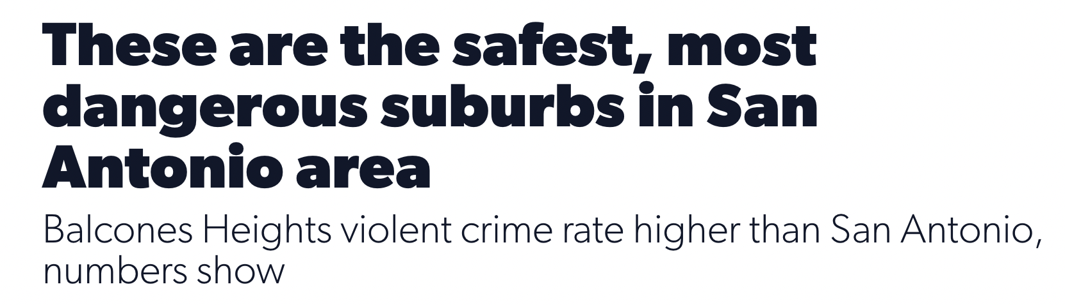
Motivation
Our understanding of crime is largely informed by local news and descriptive statistics
https://www.ksat.com/news/local/2021/10/25/these-are-the-safest-most-dangerous-suburbs-in-san-antonio-area/

Slide 3


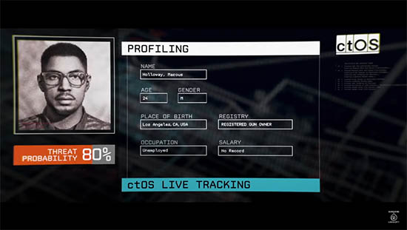
Motivation
Different approach to understanding the frequency of crime
Create a predictive model for occurrences of crime throughout the city
Not predict whether an individual will commit a crime

Slide 4
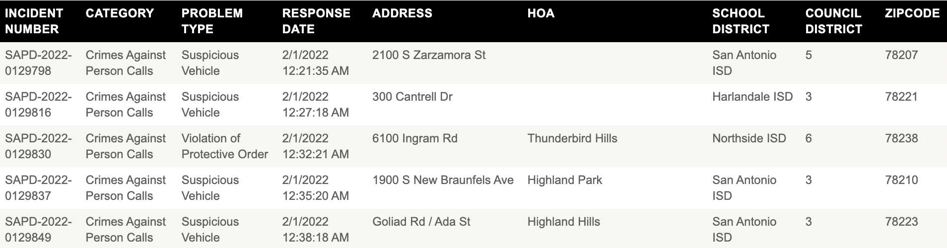
Dataset
The SAPD has a dataset of all calls for service across the city
Problem Categories: Crimes Against Person, Property Crime, Traffic, Other
Used May 2021 – April 2022 (112280 records)
https://www.sanantonio.gov/SAPD/Calls

Slide 5
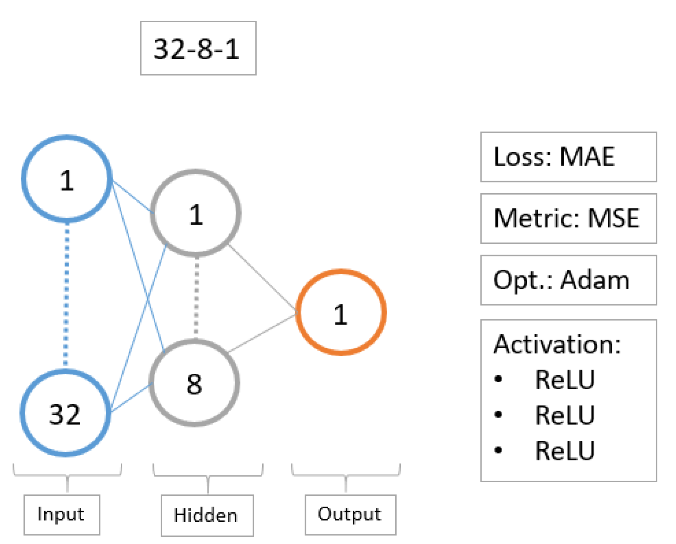
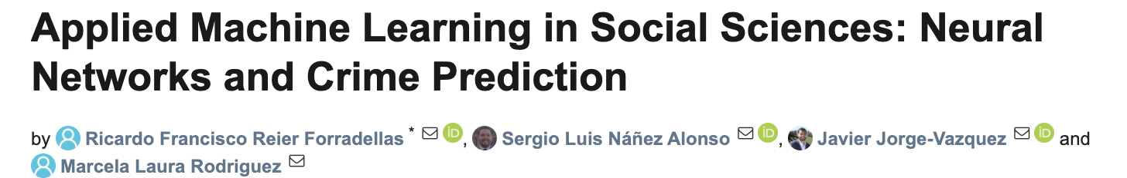
Goal
Follow literature to apply a neural network to the SAPD Calls for Service dataset
Create a predictive model for the number of calls for a given zip code by problem type
https://www.mdpi.com/2076-0760/10/1/4
Selected network architecture

Slide 6
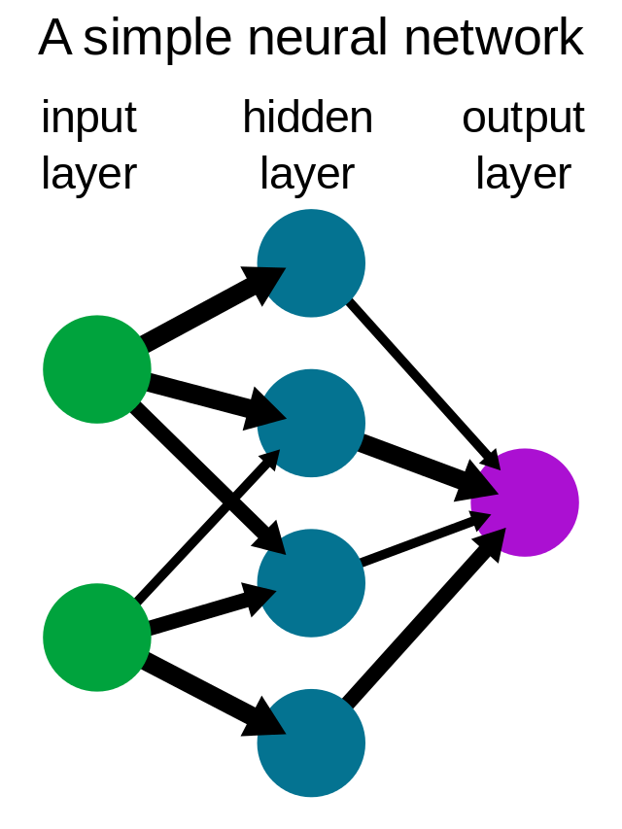
What is a neural network?
Node: basically a linear regression
Each has associated weight and threshold
Sends data to next layer if activated
Neural networks train on data to determine weights
Use gradient descent to minimize error
Black box: hard to know exactly why they work
Optimize for best results

Slide 7
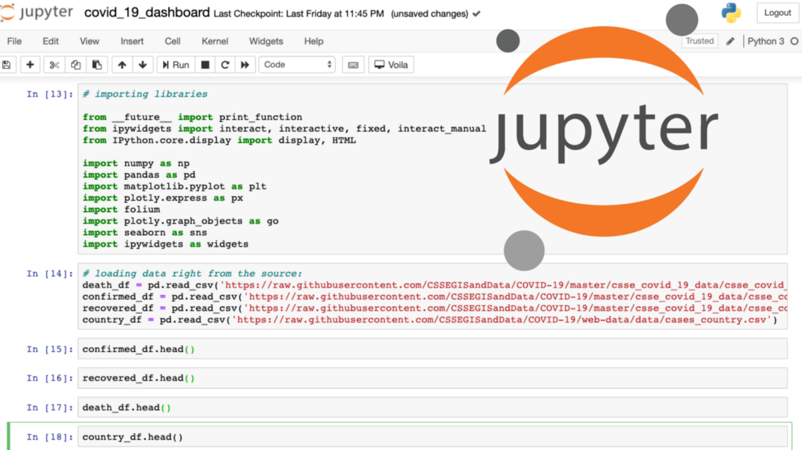


Tools
Python
Data science libraries: pandas, matplotlib, scikit-learn, numpy, seaborn
TensorFlow
Open source ML/AI library
Developed by Google
Keras
TensorFlow 2 API
Anaconda
Jupyter Notebook
Notes:
Keras is used to quickly build and test machine learning models using TensorFlow as a backend. Most often used for prototyping, full-scale applications will likely use TensorFlow directly. Anaconda is a data science platform, specifically used jupyter notebook, which is essentially a more graphical python shell.

Slide 8
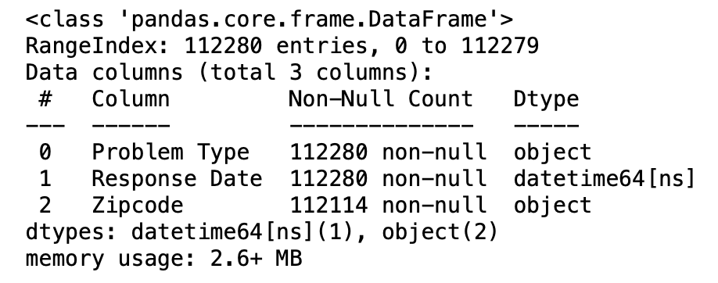
Preprocessing – Zip Code
Zip code is intended level of detail
Drop other geographical attributes
Also drop incident number
166 rows with no zip code
One with a zip code ‘s’
Some records have 9-digit zip codes
Keep only first five
Last four represent specific delivery routes

Slide 9
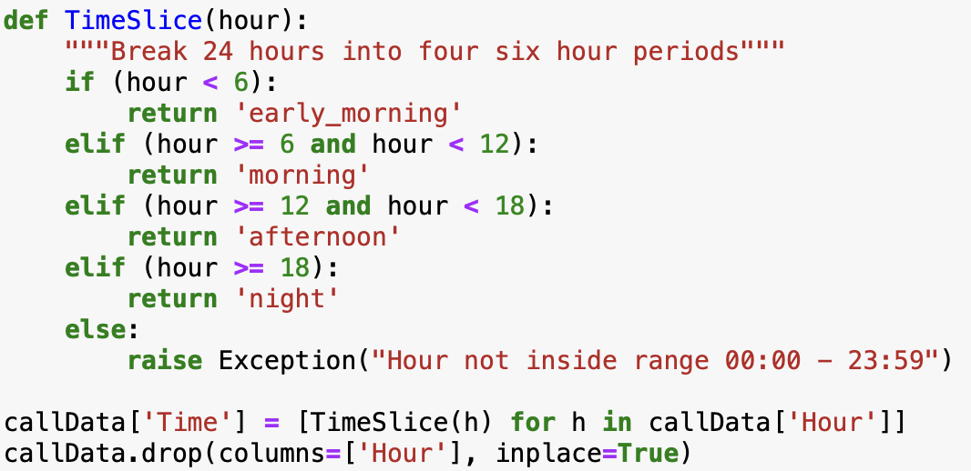
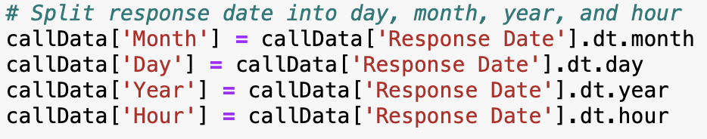
Preprocessing - Time
Separate response date into day, month, year, hour
Group hours into four six-hour periods
12AM – 5:59AM, 6AM – 11:59PM, 12PM – 5:59PM, 6PM – 11:59PM

Slide 10
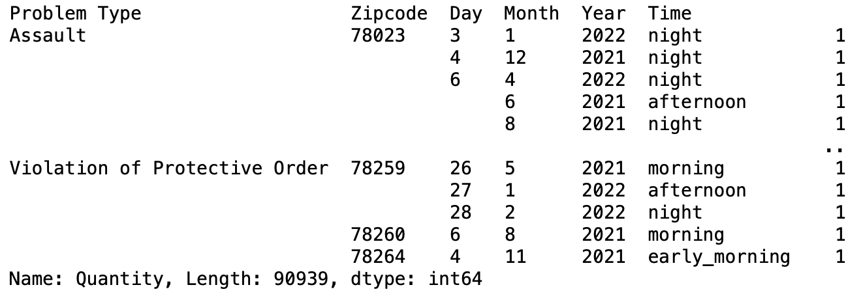
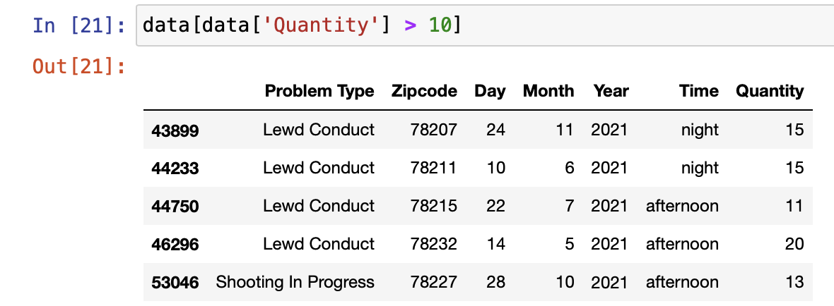
Preprocessing – Quantity
Need to create target attribute
First assign every record a quantity of one
Group by predictive attributes and sum quantity
19% reduction in dataset

Slide 11
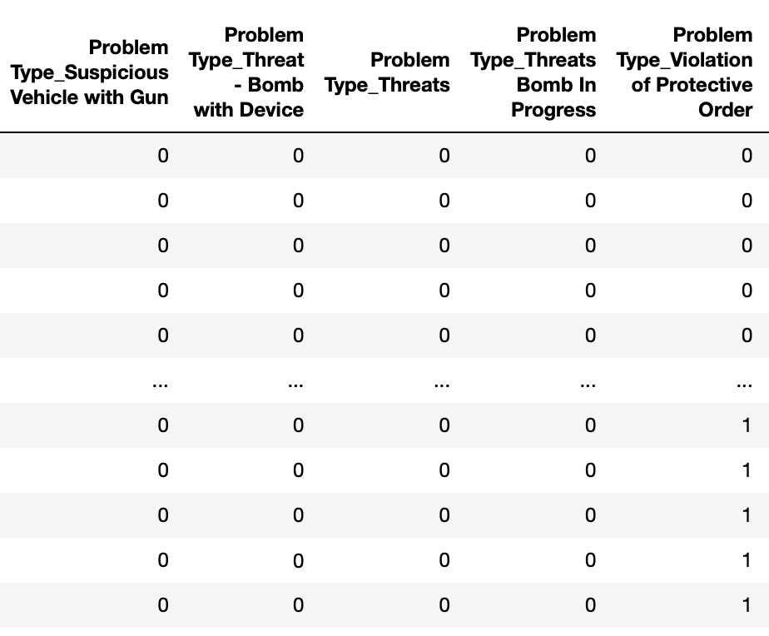
Preprocessing – Categorical Variables
Need to turn categorical variables into integers
Use One-Hot Encoding
Turns every category into a binary value
1 if present, 0 if not
Done for zip code, time, and problem type

Slide 12
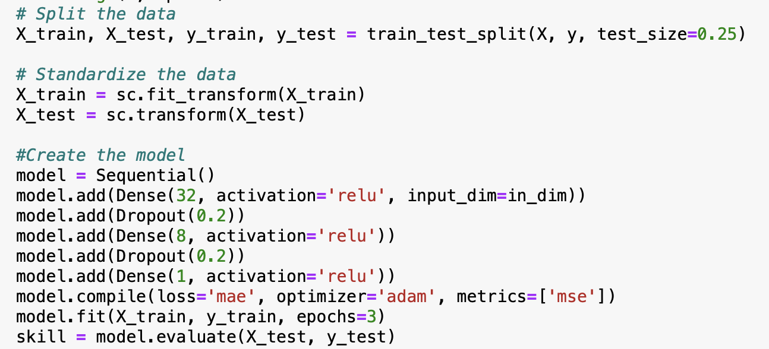
Creating the model
Created sequential regression using Keras
Trained on 75% of the dataset
Used parameters in literature
Added dropout regularization

Slide 13
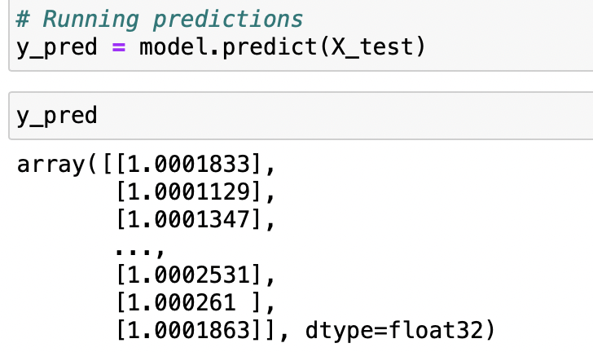
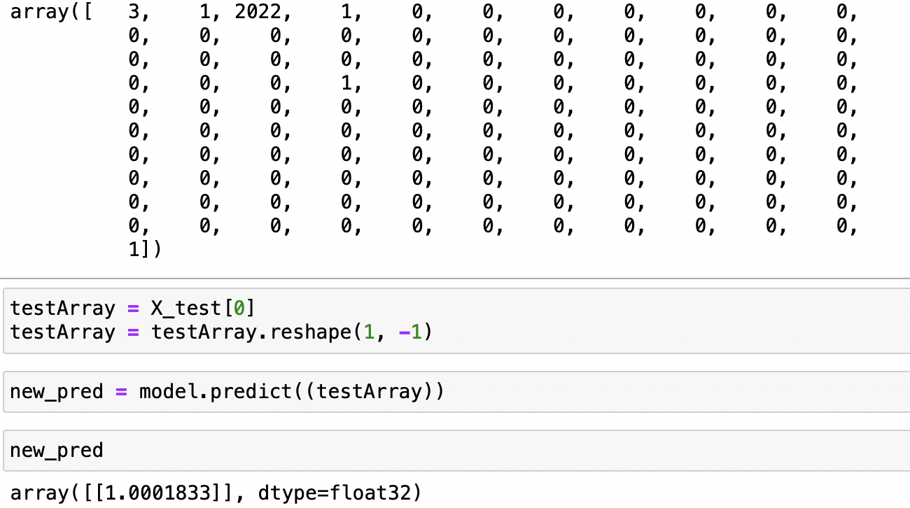
Making Predictions
Need to pass day, time, month, year, problem type, and zip code
Can predict one at a time or multiple

Slide 14
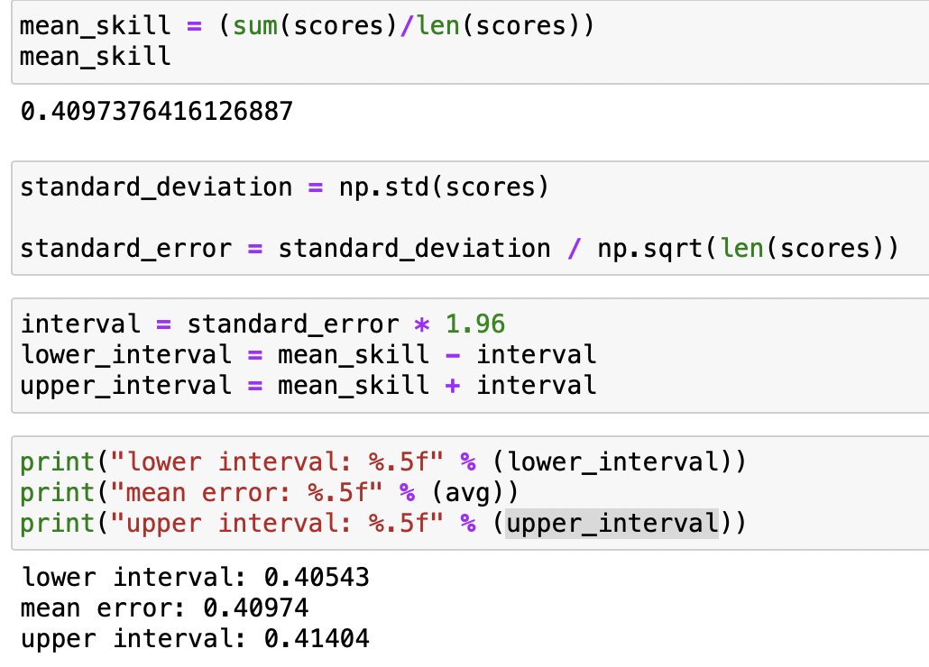
Model Evaluation
Repeatedly evaluated model against test set 30 times
Created 95% confidence interval

Slide 15
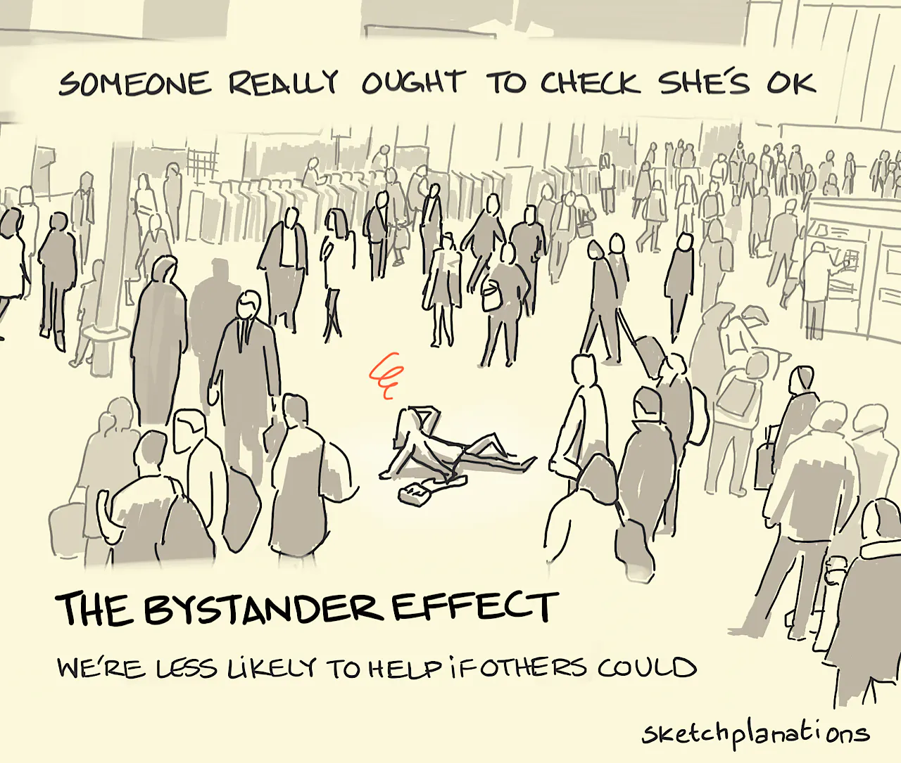
Threats to validity
Literature parameters may not be the best fit
Dataset size
Could train on more historical data
Potential issue with 2020 lockdowns
Calls for service, not crime reports
Repeated calls
Prank calls
Actual crime differs from call
Notes:
Chose year for more efficient training and optimization, and potential for outliers in 2020 data. Calls for service data was used because that was the only dataset that provided detailed space and time data for individual crimes. Cannot train on uniform crime report.

Slide 16
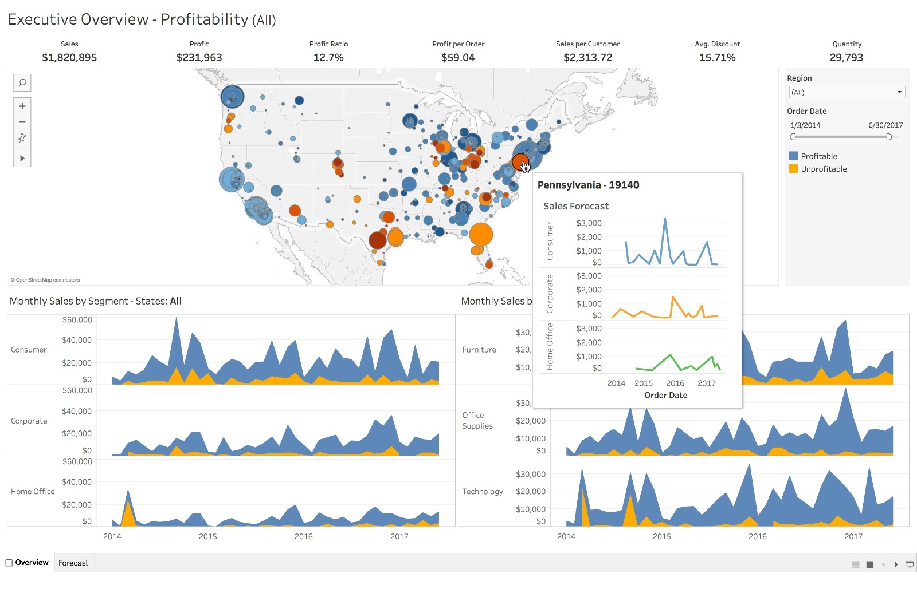
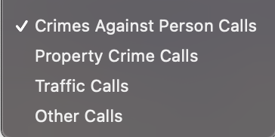

Future Work
Hyperparameter Tuning of model
Incorporate more historical data
Call data goes back to 2011
Include or create models for other problem types
Only trained on ”Crimes Against Person Calls”
Create data dashboard with Tableau or Power BI
Product that anyone could use
Visualize predictions

